Slide 1

Exploratory Data ANALYSIS TITANIC Machine Learning from Disaster
- SATYABRATA ROY

Slide 2
FLOW OF Exploratory Data Analysis [EDA]
Basic Dataset Exploration
Statistical Analysis of Numerical Features
Univariate Analysis of Numerical Features
Univariate Analysis of Categorical Features
Multivariate Analysis

Slide 3
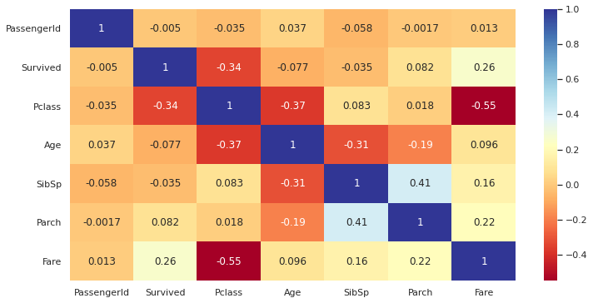
 | Survived
Survived | 1.000000
Pclass | 0.338481
Fare | 0.257307
Parch | 0.081629
Age | 0.077221
SibSp | 0.035322
PassengerId | 0.005007

Slide 4
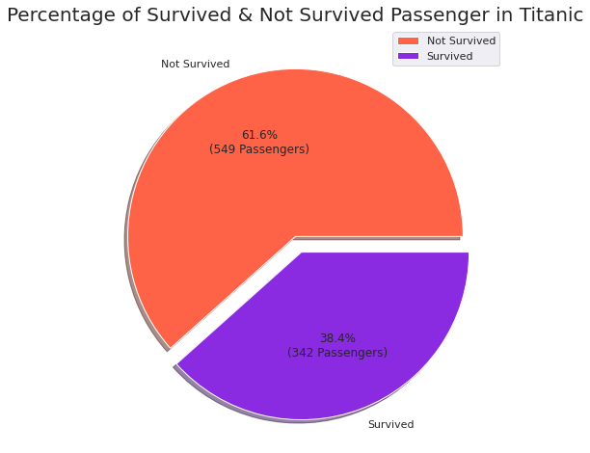
61.6% of the Total Passengers are Not able to survive
38.4% of the Total Passengers are able to survive

Slide 5
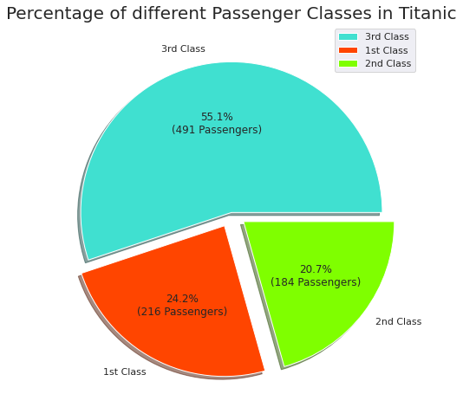
55.1% of the Passengers Had the ticket of 3rd Class
24.2% of the Passengers Had the ticket of 1st Class
20.7% of the Passengers Had the ticket of 2nd Class

Slide 6
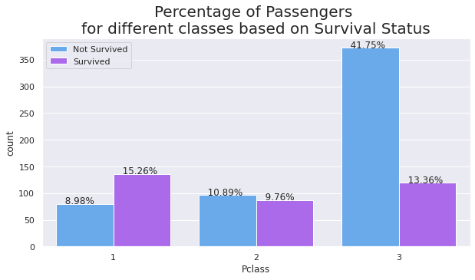
majority of the passengers (41.75%) who were travelling in Economy (3rd) Class of Titanic were not able to survive

Slide 7
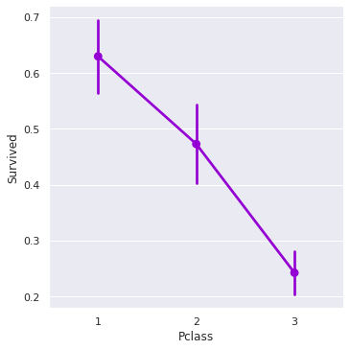
1st class passengers had highest survival rate
3rd class passengers had lowest survival rate

Slide 8
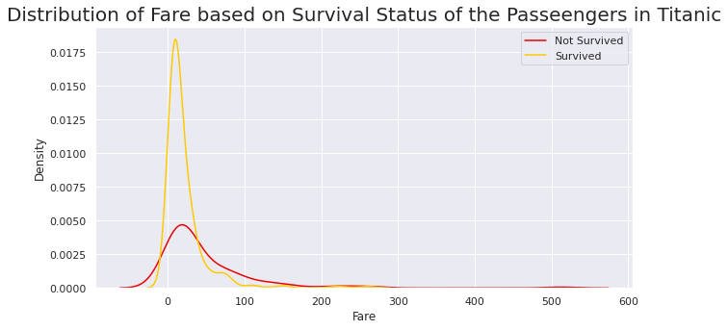

Slide 9
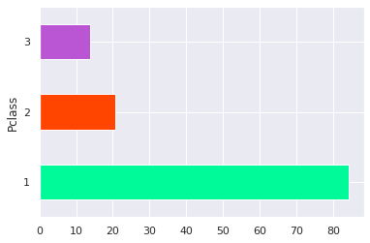
Average Fare of 1st, 2nd and 3rd Passenger Class is 84, 20, 13 dollars respectively.

Slide 10
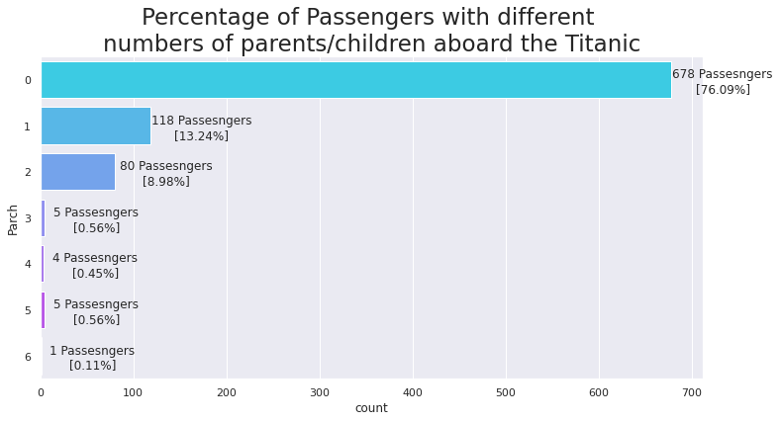
MAJORITY (76.09%) of the Passengers was travelling alone

Slide 11
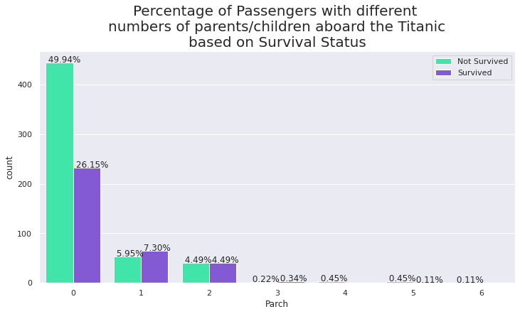
50% of the total passengers in Titanic who were travelling alone, not able to survive.

Slide 12
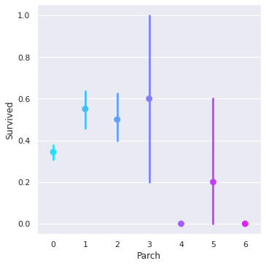
Passengers who were travelling with total 3 family members (including himself/herself) has the highest survival rate.

Slide 13
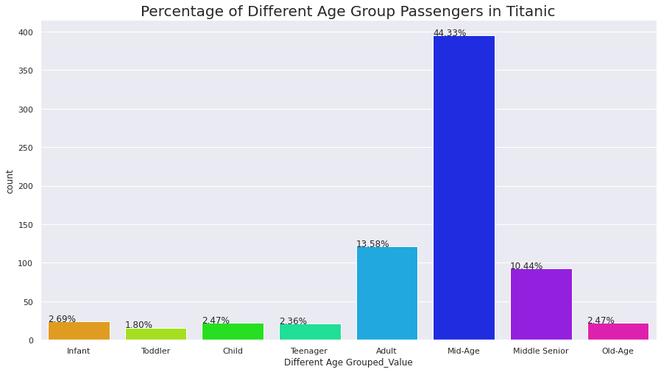
0 - 2 ---> Infant
2 - 4 ---> Toddler
4 - 9 ---> Child
9 -15 ---> Teenager
15 - 21 ---> Adult
21 - 44 ---> Mid-Age
44 - 60 ---> Middle Senior
60 - 80 ---> Old-Age
MAJORITY (44.33%) of the Passengers belongs to Middle age group

Slide 14
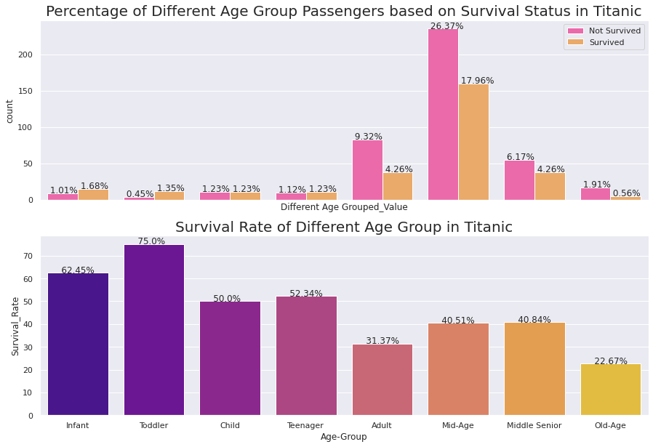

Slide 15
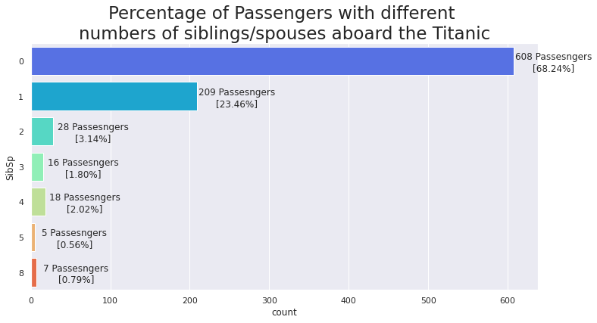
68.04% of the Passengers was travelling without any Siblings/spouses

Slide 16
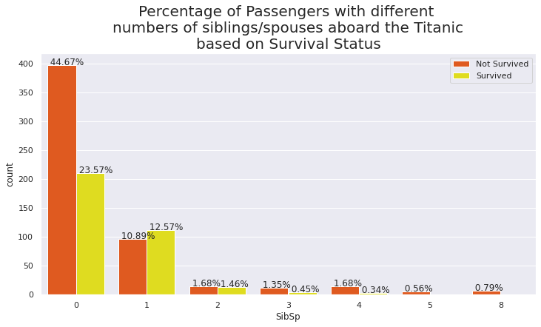

Slide 17
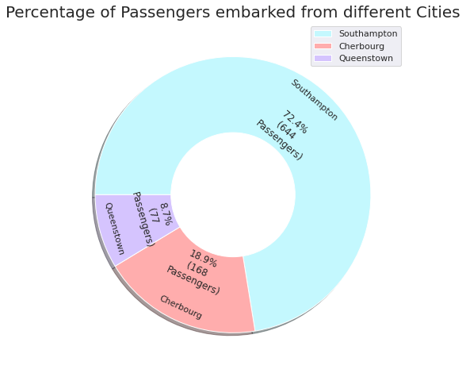
MAJORITY (72.4%) of the Passengers Embarked FROM Southampton
Only 8.7% of the Passengers Embarked FROM Queenstown
18.9% of the Passengers Embarked FROM Cherbourg

Slide 18
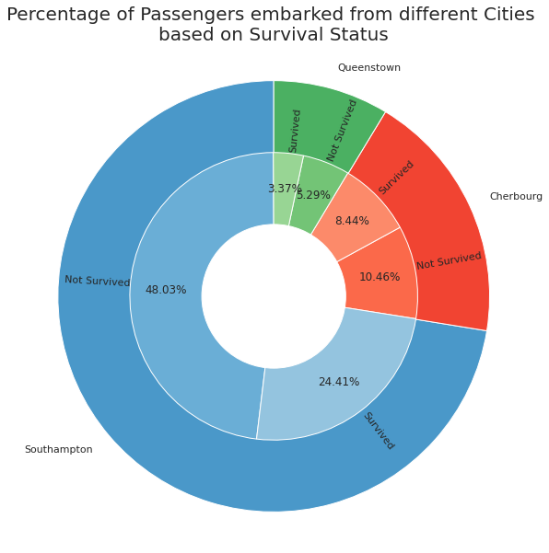
48% of the total passengers in Titanic who embarked from Southampton Port not able to survive.

Slide 19
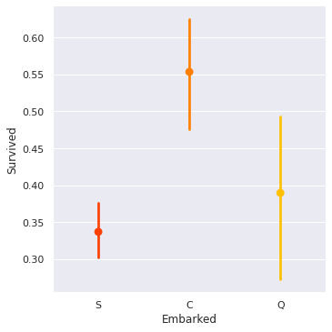
Passengers who embarked from Cherbourg Port had highest survival rate
Passengers who embarked from Southampton Port had lowest survival rate

Slide 20
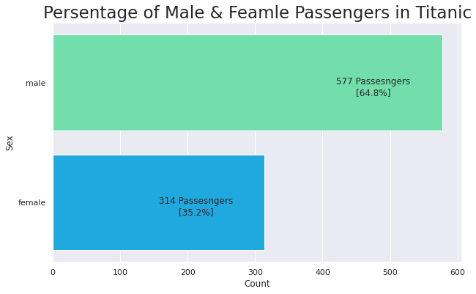
MAJORITY (64.8%) of the Passengers is MALE
ONLY (35.2%) of the Passengers is FEMALE

Slide 21
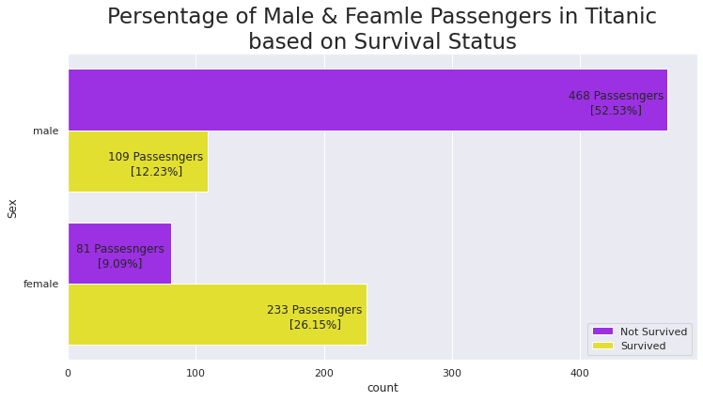

Slide 22
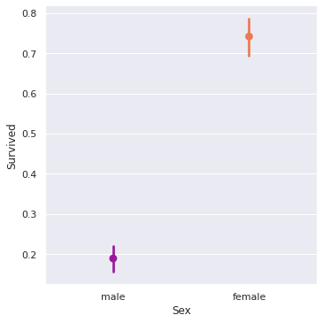
Overall the Survival rate of Female passengers is almost 4 times greater than the Male passengers.

Slide 23
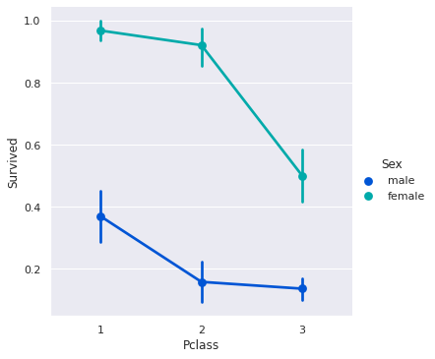
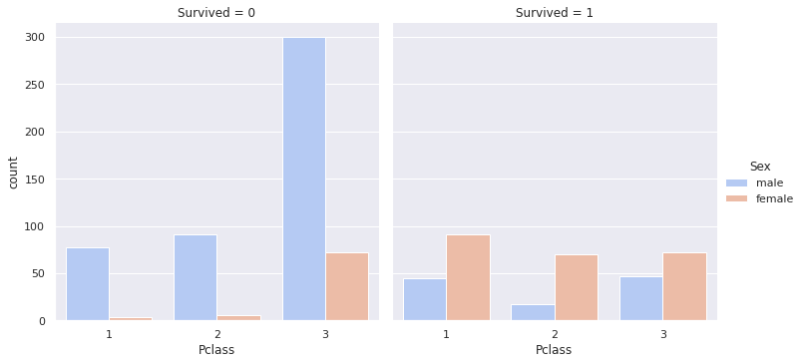

Slide 24
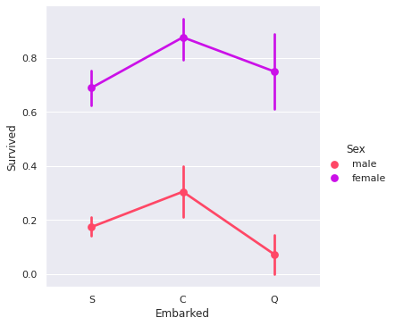
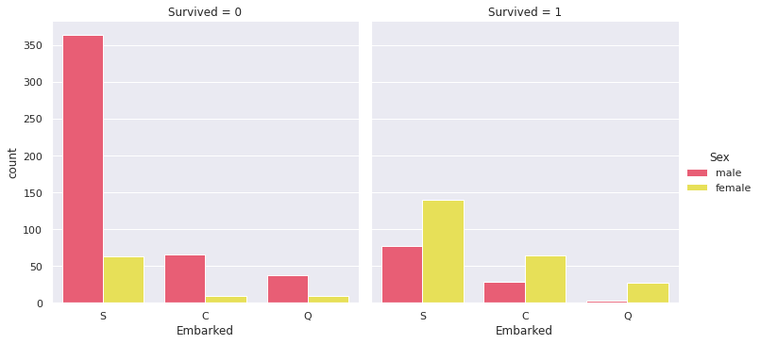

Slide 25
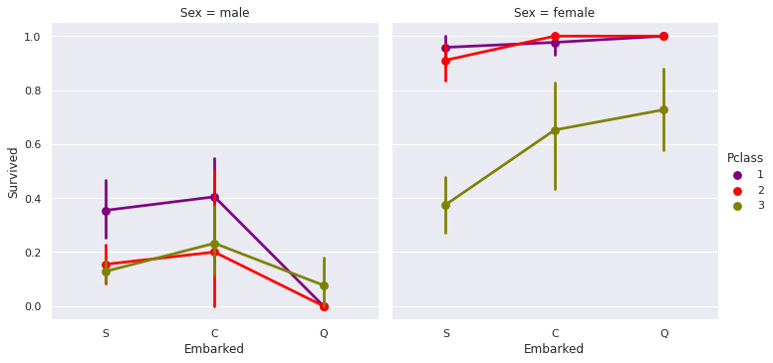

Slide 26
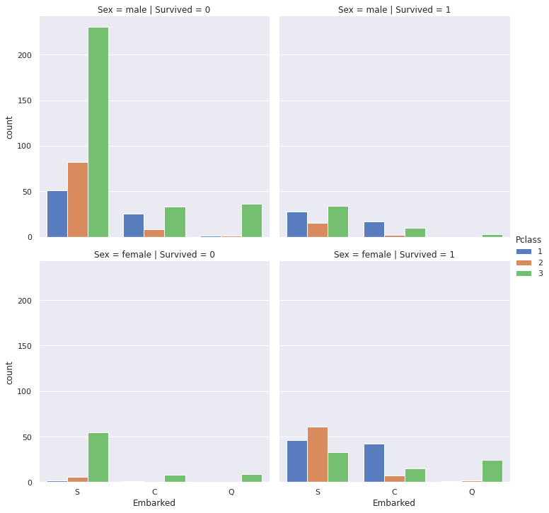

Slide 27
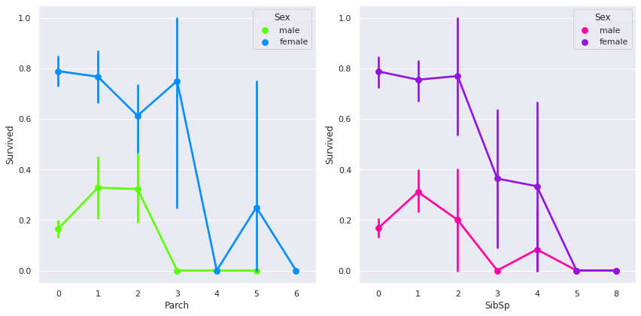

Slide 28
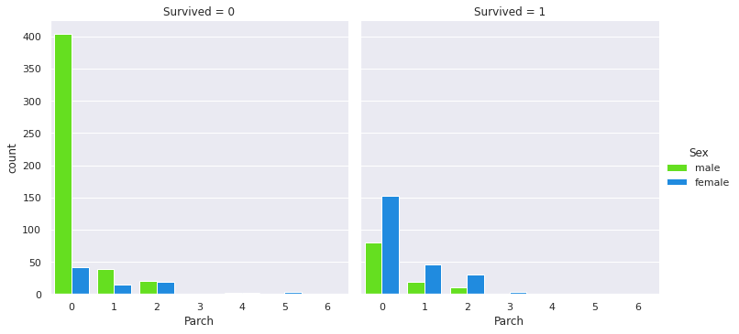

Slide 29
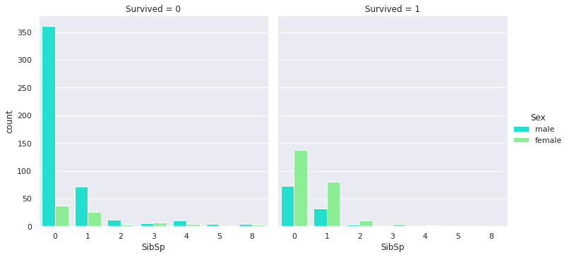

Slide 30
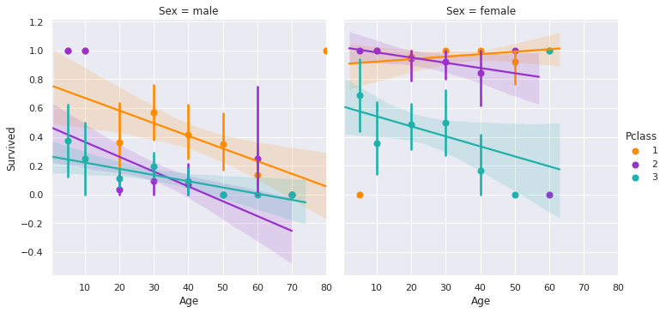

Slide 31
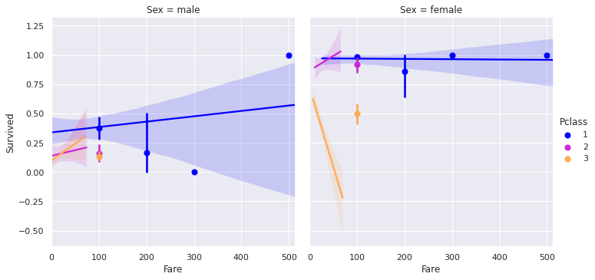

Slide 32
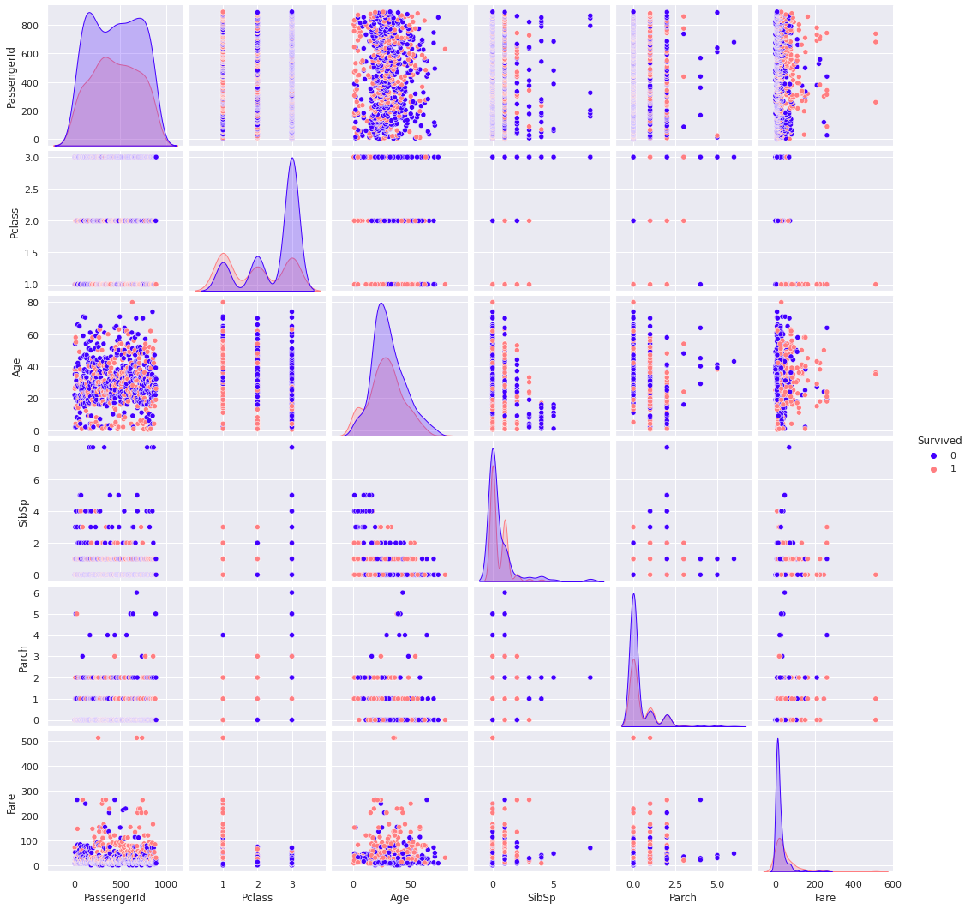

Slide 33
Thank You !!

